Slide 1


Bridging the Gap: Education, Wages, and Labour Market Outcomes in Ontario
Capstone Project | Group 5.

Slide 2

Project Introduction
Education, Immigration, and Labour market conditions play a major role in shaping income outcomes in Ontario. As Canada’s most economically active province, Ontario attracts a diverse workforce from different backgrounds.
This project explores who earns more, who falls behind and why using data-driven analysis.
Our main focus is on wage inequality across education level, gender, job type and Immigration status.

Slide 3

Research Questions.
Do immigrants earn lower wages than Canadian-born workers in Ontario?
Does higher education reduce wage inequality?
Do gender wage gaps still exist in today’s labour market?
How do differences in hourly wages translate into annual income gaps?

Slide 4

Dataset Overview.
The dataset analyses Ontario’s Labour market using the education level data from Open Ontario (2006 - 2022) and CIS data from Statistics Canada (2018 - 2022).
The CIS data was originally provided in TXT format, cleaned, merged with Statistics Canada data using Python, and visualized in Tableau.
Key variables used in this analysis include:
Education
Gender
Immigration Status
Type of work
Hourly Wages
Annual Income

Slide 5

Methodology
Collected Ontario demographic and education data from Open Canada (2006- 2022) and income data from Statistics Canada (2018-2022).
Cleaned and merged both datasets using Python (Pandas and Numpy).
Converted raw text files into structured, analysis- ready datasets
Handled missing values and standardized key variables across all categories.
Performed exploratory data analysis to examine trends and group differences.
Built interactive dashboards in Tableau to analyze wages by Education, Immigration Status, Gender, Type of Work.
Interpreted results to identify key wage and income inequality patterns.

Slide 6
Dashboard

Slide 7
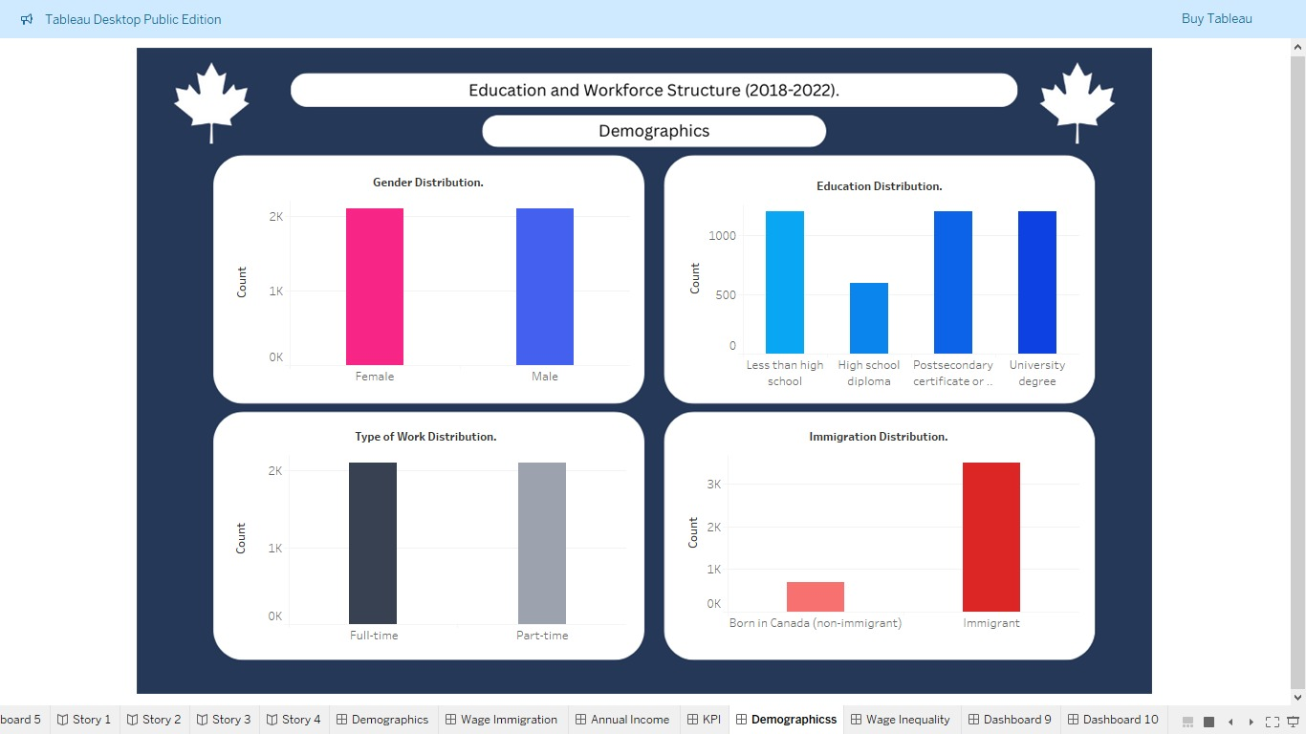

Slide 8
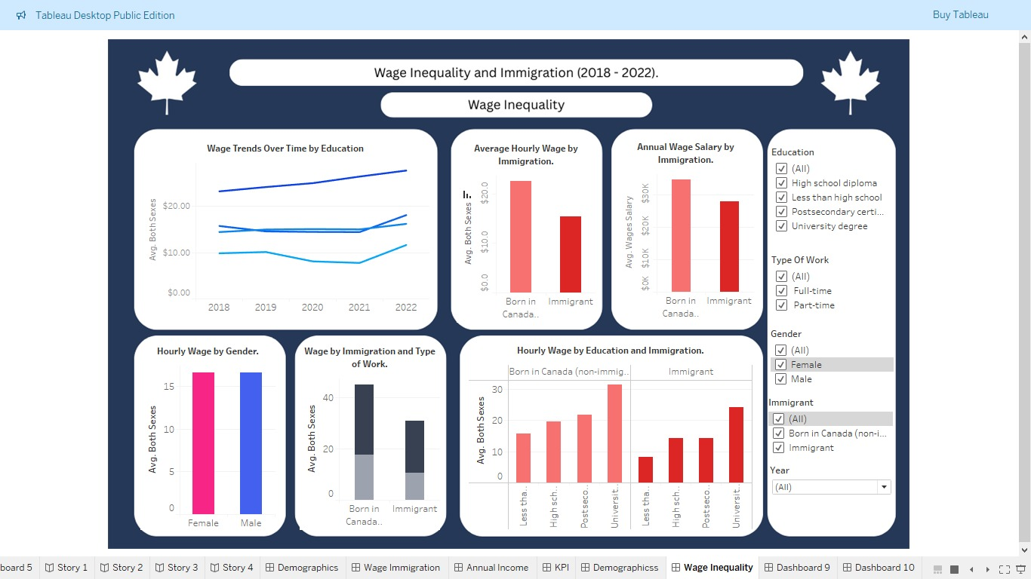

Slide 9
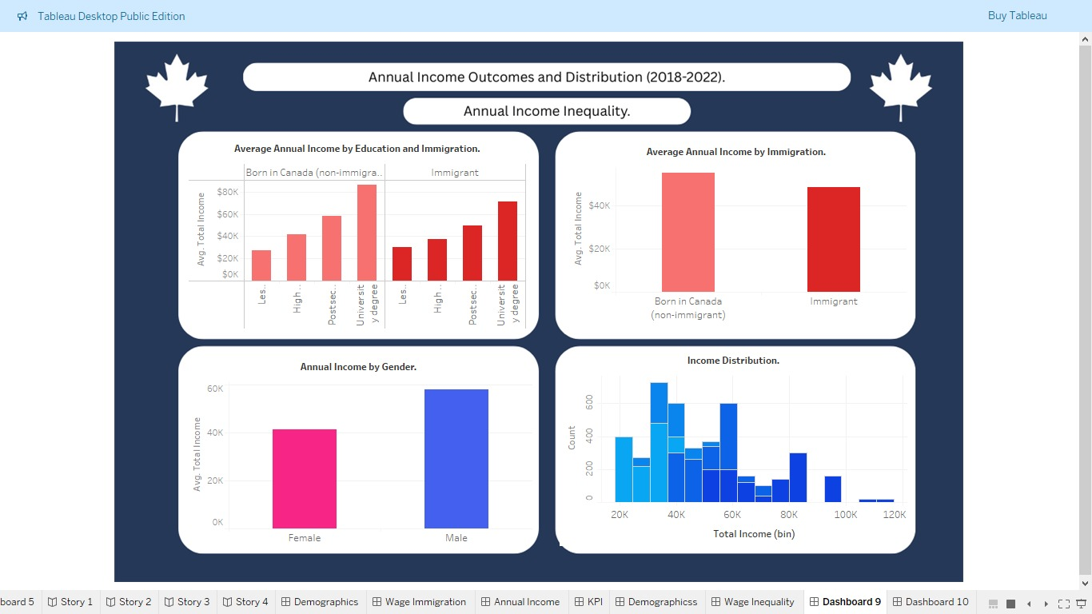

Slide 10
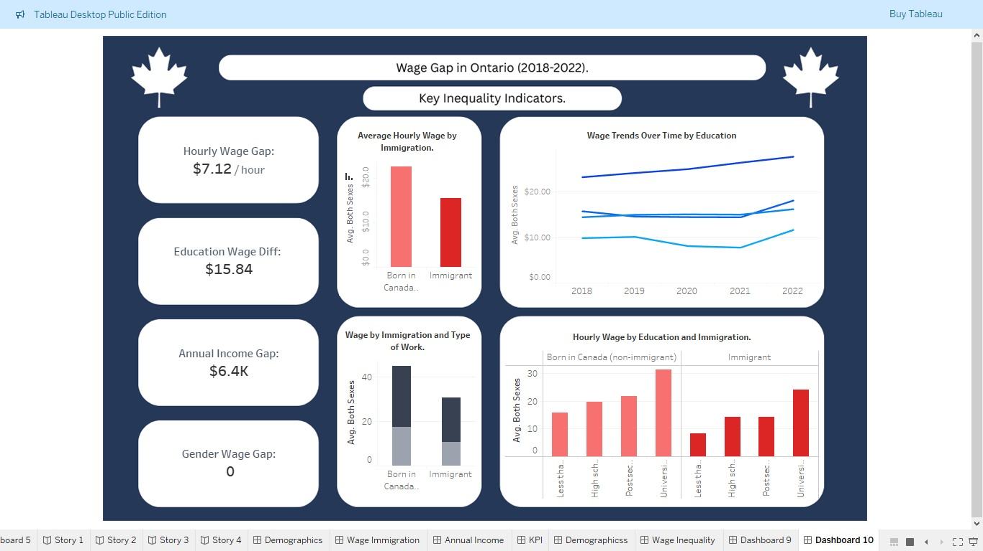

Slide 11
Key Insights.
Hourly wages increase with higher education levels.
Immigrants earn less than Canadian-born workers at every education level.
The wage gap between immigrants and Canadian-born remains even in full-time employment.
There’s little to no hourly wage difference between males and females in this dataset.
University graduates earn the highest hourly and annual incomes.
The income gap between immigrants and non-immigrants is largest at higher education levels.
Wages showed a temporary decline during 2020-2021 due to COVID-19, but recovered afterward.

Slide 12
Challenges and Recommendations

Slide 13
Challenges
The data is ethically anonymized and aggregated, which means individual career paths cannot be tracked.
This dataset contains more immigrant observations than Canadian-born workers, which may affect how representative some comparisons are.
The analysis focuses only on Ontario, so the results cannot be generalized to all of Canada.
Occupation and industry-level details are not available, limiting deeper explanations of Job-specific wage differences.
Some wage differences may be influenced by full-time or part-time work, not only by education or immigration status.

Slide 14

Recommendations
Employers should be encouraged to adopt standardized pay structures and promotion policies to reduce unfair wage differences.
Expand access to Canadian work experience through internships, co-op placements.
Improved foreign credential recognition systems so immigrants can work in fields matching their education.
Develop more affordable and accessible re-certification programs to help immigrants meet Canadian licensing requirements.

Slide 15

Future Work
Future studies can include job types and industry data to better explain why wage gaps exist across different kinds of work.
A longer time range can be used to track how wages change over many years and not just short-term trends.
Comparing Ontario with other provinces can help identify whether these wage gaps are unique to Ontario or part of a national trend.
Adding more employee background details where necessary could help better explain what drives wage differences.

Slide 16

Thank You
Group Members:
Ameenat Ali - 0873961
Foluso Ojo - 0876471
Gupreet Kaur - 0877408
Pei- Ru Chen - 0863567

